Slide 1





TTTC3213 Group Project
ETL Process for Shopify Online Shopping Website
GROUP 8
Group member
A204179 YANG HANGYU
A191702 YU YIFAN

Slide 2
Project Goal & Introduction
Introduction
Project Goal
The aim of this project is to perform a complete ETL (Extract, Transform, Load) process on an online shopping/business website and generate a simple but meaningful analysis report. Through this project, we demonstrate the ability to collect raw web data, clean and transform it into a usable format, and analyze the data using visual comparisons to support insights.
This project focuses on transforming unstructured or semi-structured web data into structured datasets that can be used for decision-making, price comparison, and basic market analysis.

Slide 3
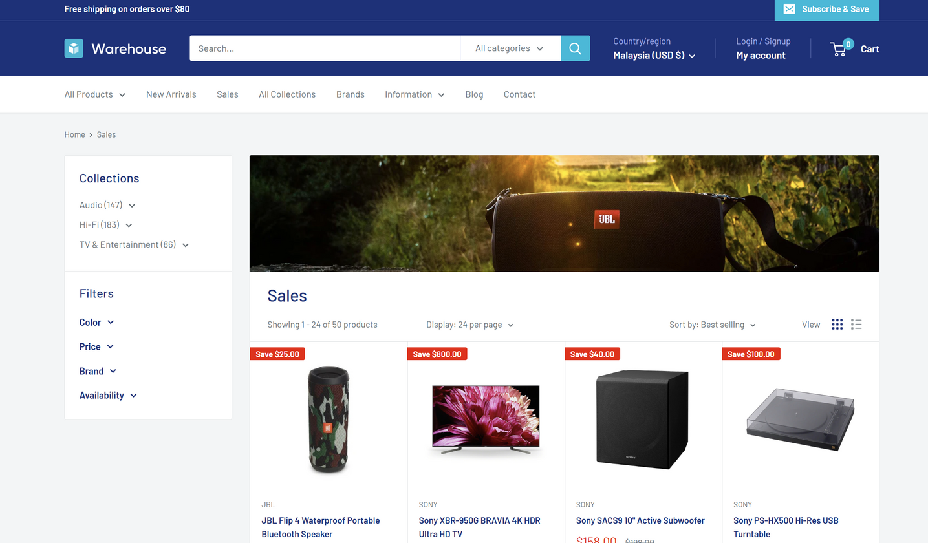
Website Selection & Data Attributes
01
Website Selection
The selected website is a publicly accessible English-based e-commerce platform that does not require user login. The data were collected for academic purposes and comply with ethical web scraping practices.
Data Scope
02
More than 100 product records were collected to support reliable analysis.
Extracted Data Attributes and Justification
03
– Product Name: Identifies each product clearly for analysis
– Price: Main attribute for analysing pricing distribution
– Brand: Enables comparison between different manufacturers
– Stock Status: Indicates product availability and supply condition

Slide 4
ETL Concept & Overview
ETL stands for Extract, Transform, and Load, which is a standard process used to handle and integrate raw data.
ETL Concept
In this project, ETL is implemented through practical steps such as web scraping, data cleaning, data storage, and data visualization.
Approach
ETL stands for Extract, Transform, and Load.It is a standard data engineering process used to integrate data from different sources into a centralized storage system.ETL ensures that data is accurate, consistent, and ready for further analysis or reporting.
ETL Overview

Slide 5
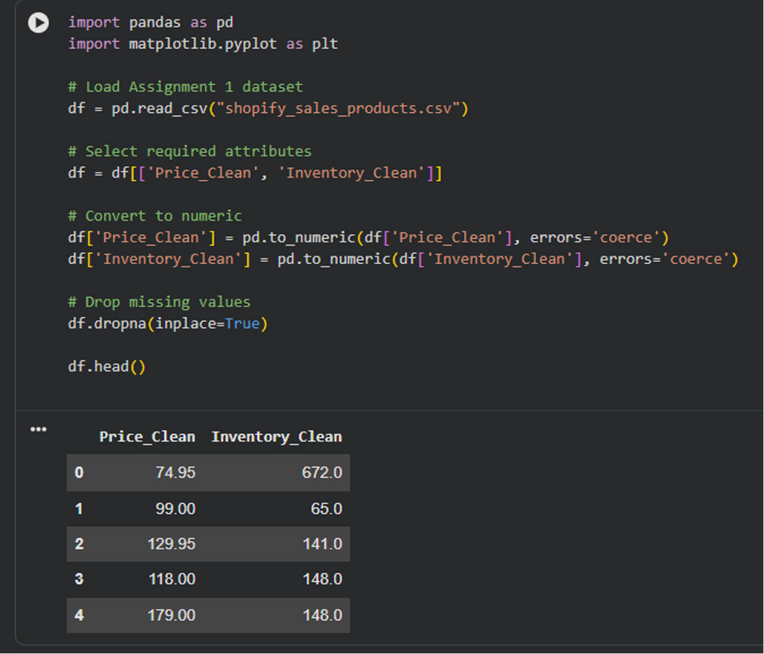
Data Scraping Process
Scraping Environment
– Google Colab (cloud-based Python environment)
Tools & Libraries Used
– requests – retrieve webpage content
– BeautifulSoup – parse and extract HTML elements
– pandas – structure and store scraped data
– re – clean and extract text patterns (price, symbols)
Scraping Workflow
Send HTTP request to the target webpage
Parse HTML content using BeautifulSoup
Locate product-related elements (name, price, brand, stock)
Store extracted data into a pandas DataFrame

Slide 6
Data Cleaning & Formatting
Purpose of Data Cleaning
Raw scraped data often contains inconsistencies, missing values, and formatting issues. Data cleaning is necessary to improve data quality and ensure accurate analysis results.
Data Cleaning and Formatting Performed
Price Formatting
Handling Missing Values
– Removed currency symbols such as RM and $
– Converted price values from text to numeric format
– Removed records with missing product names or prices
– Filled missing stock status as “Unknown”
Text Standardisation
Duplicate Removal
– Converted brand names to lowercase
– Trimmed extra spaces in product names
– Identified and removed duplicated product records to ensure data accuracy

Slide 7
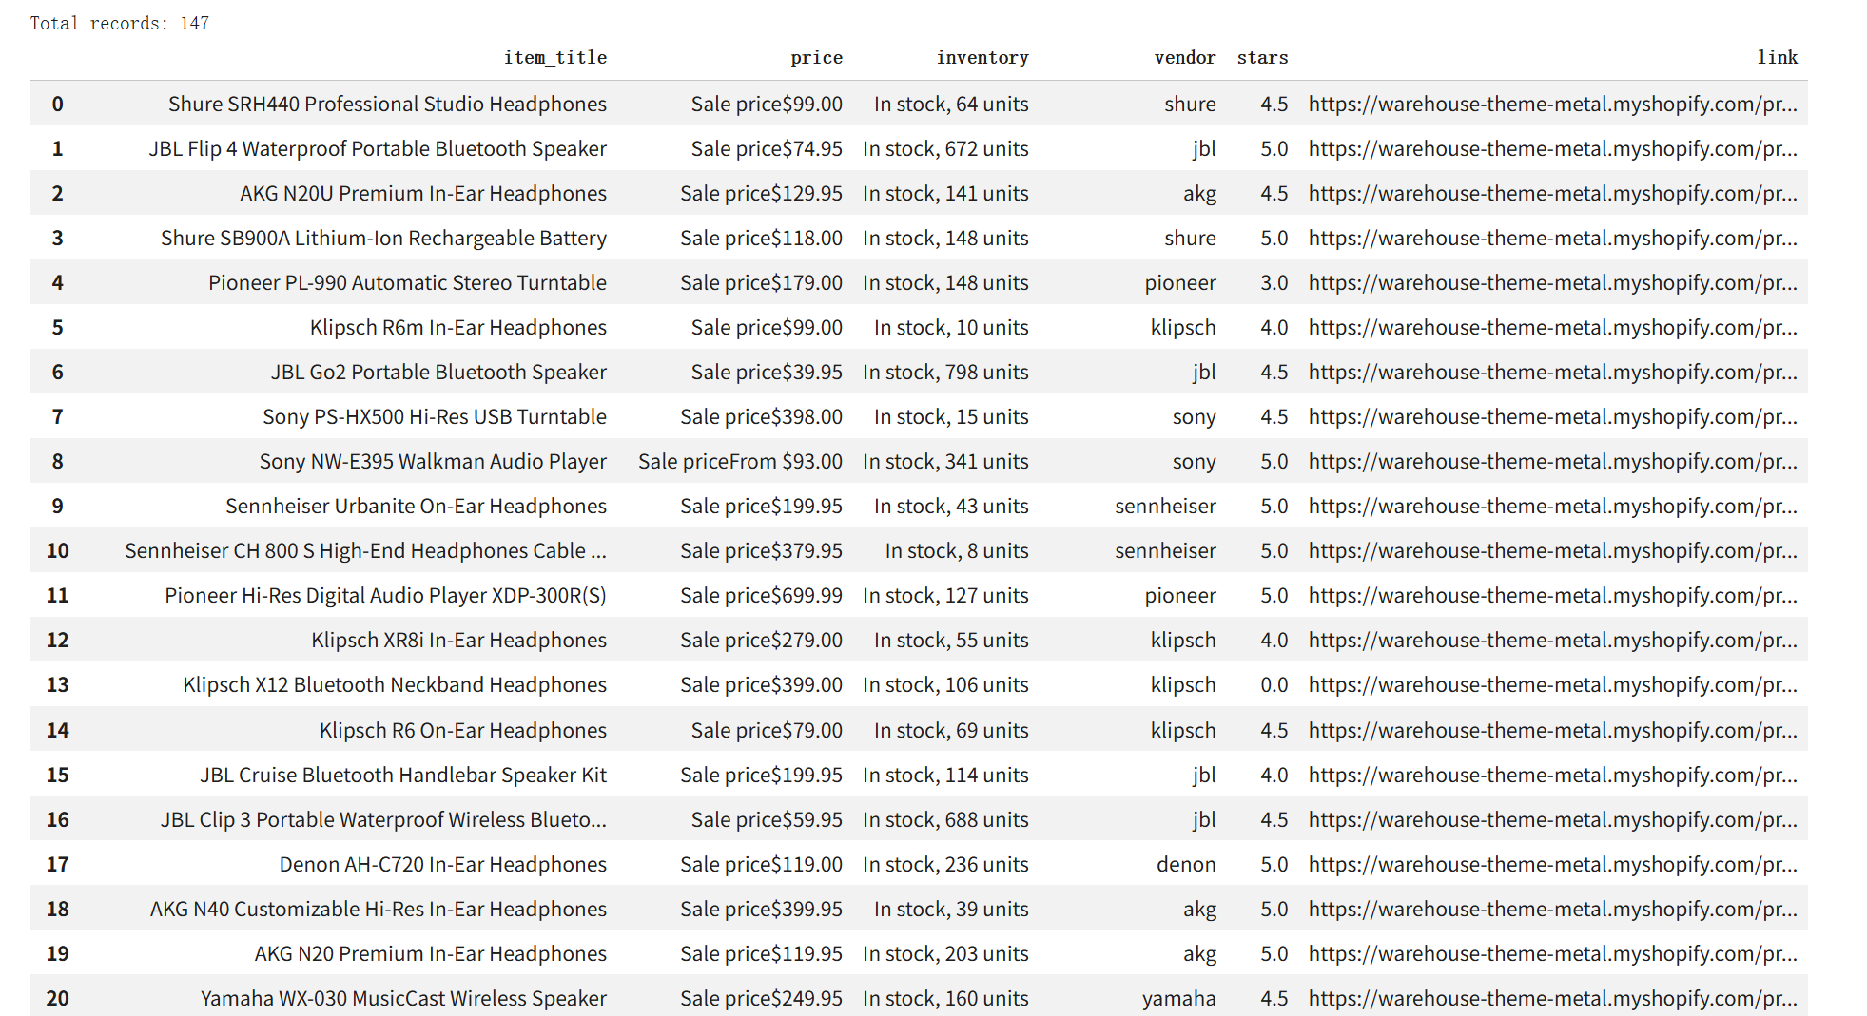
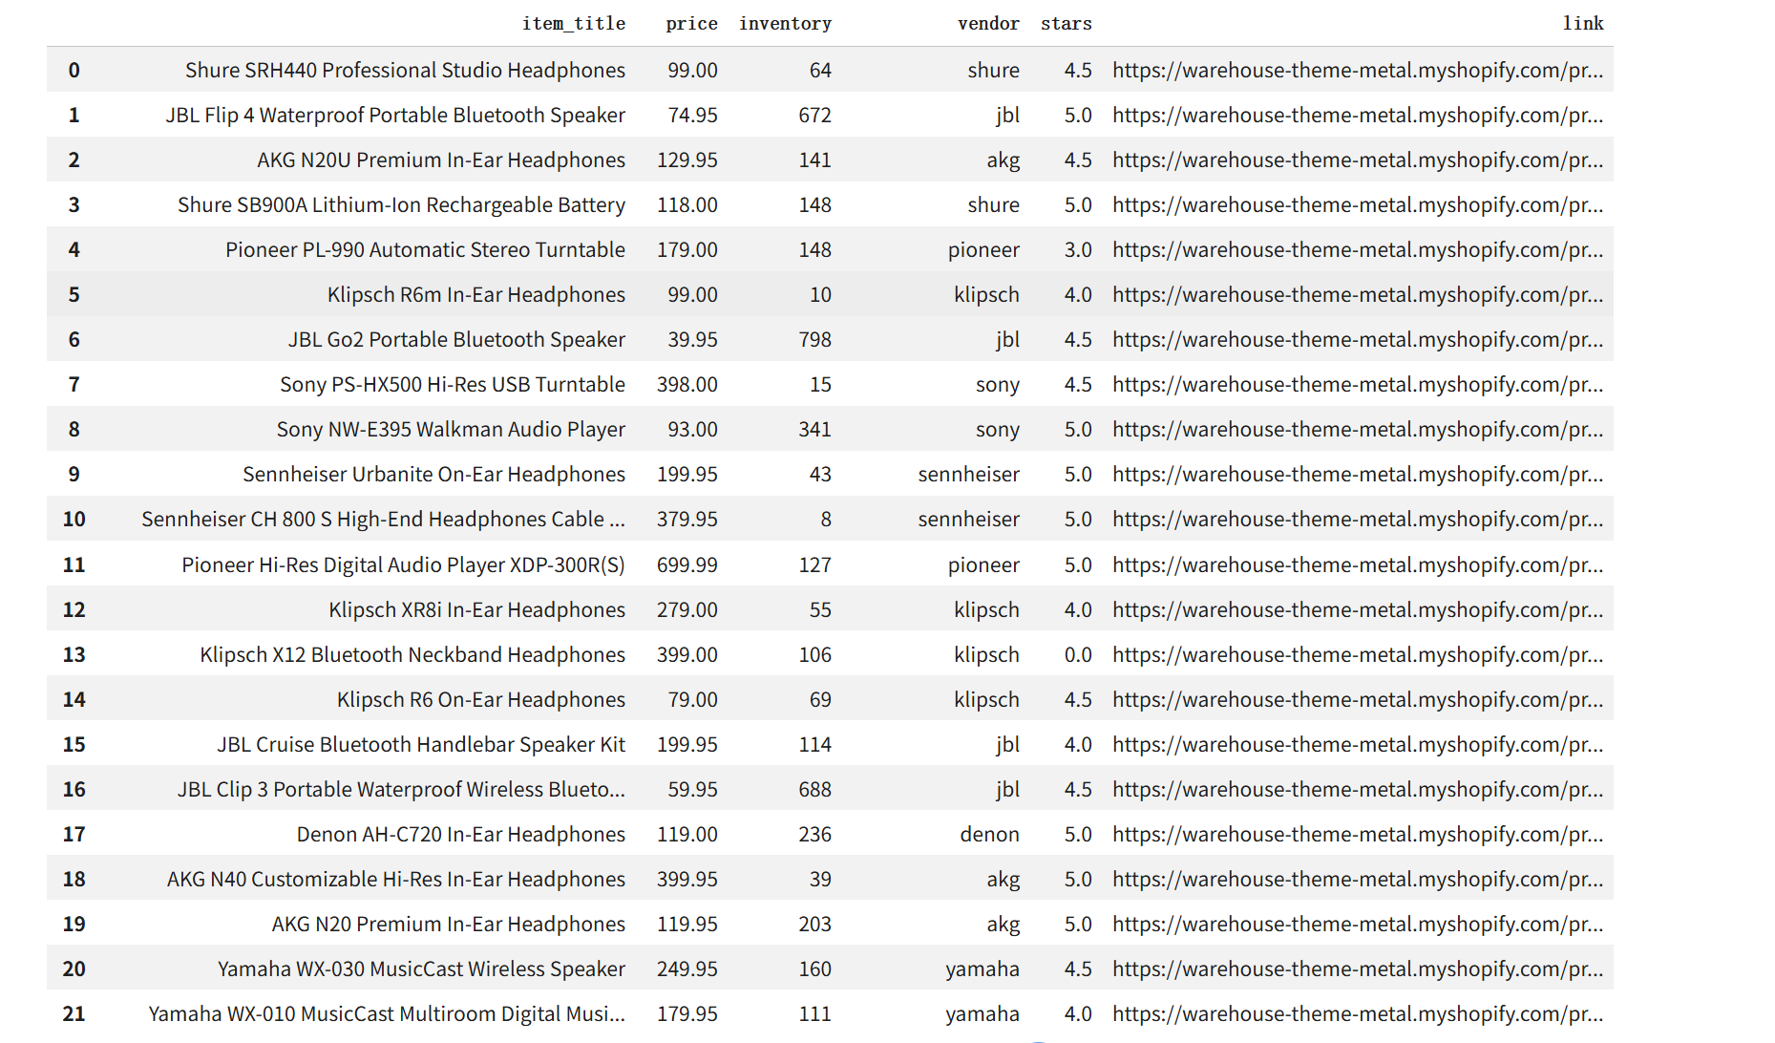
Before vs. After Cleaning
Cleaning Results (After):
1. Type Conversion: 100% of Price and Rating columns converted to float64 for calculation.
2. Regex Extraction: Extracted pure integers from inventory strings using pattern matching.
3. Standardization: Normalized Vendor names to ensure accurate brand-level grouping.
4. Integrity: Dropped invalid records, resulting in a high-quality dataset of 100+ items.
Data Challenges (Before):
Mixed Formats:Prices and ratings contained symbols ($) and descriptive text ("4.5 out of 5").
Inconsistent Strings: Inventory levels were buried in phrases like "In stock (24)".
Noise: Presence of duplicates and products with missing critical values (NaN).

Slide 8
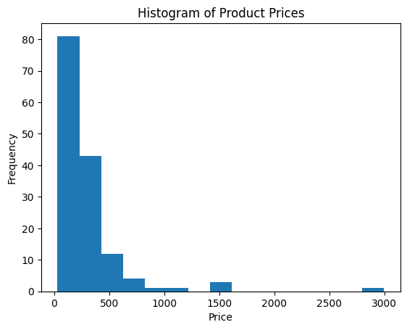
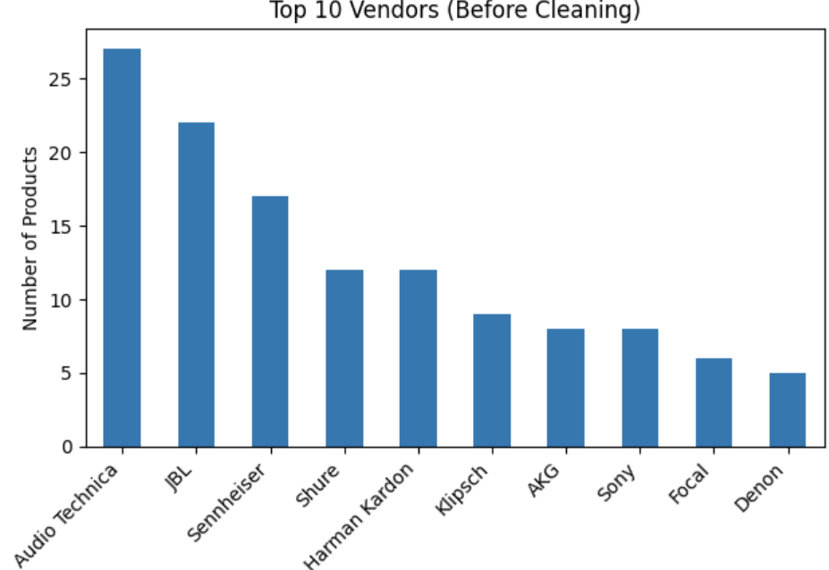
Product Distribution Analysis
Price Distribution
Products by Vendor
The first chart shows the number of products offered by each vendor, highlighting vendor dominance in the store.
The histogram shows that most products are concentrated in the mid-price range, indicating a competitive pricing market with a small number of high-priced items.

Slide 9
Conclusion & Deliverables
In conclusion, this project demonstrates how ETL principles can be applied to an online shopping website using real-world data.
Through web scraping, data cleaning, and data formatting, raw Shopify product data is transformed into structured and reliable data.
The cleaned dataset enables meaningful data analysis and visualization, such as product distribution and price analysis.
Overall, this project highlights the importance of the Transform stage in ensuring data quality and supporting accurate insights.

Slide 10
TTTC3213 Group Project
Thank you for watching
GROUP 8
group member
YANG HANGYU
A204179
YU YIFAN
A191702

